Slide 1
AWS TOOLS USED IN ML

Slide 2
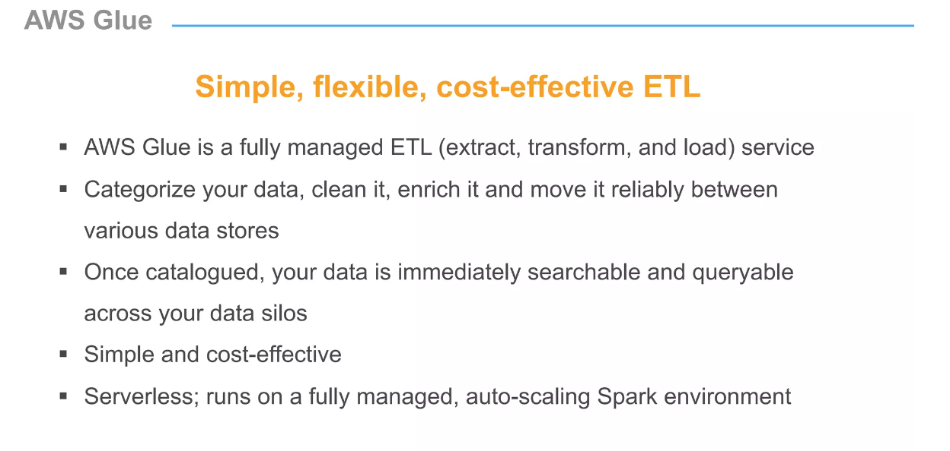
AWS GLUE

Slide 3
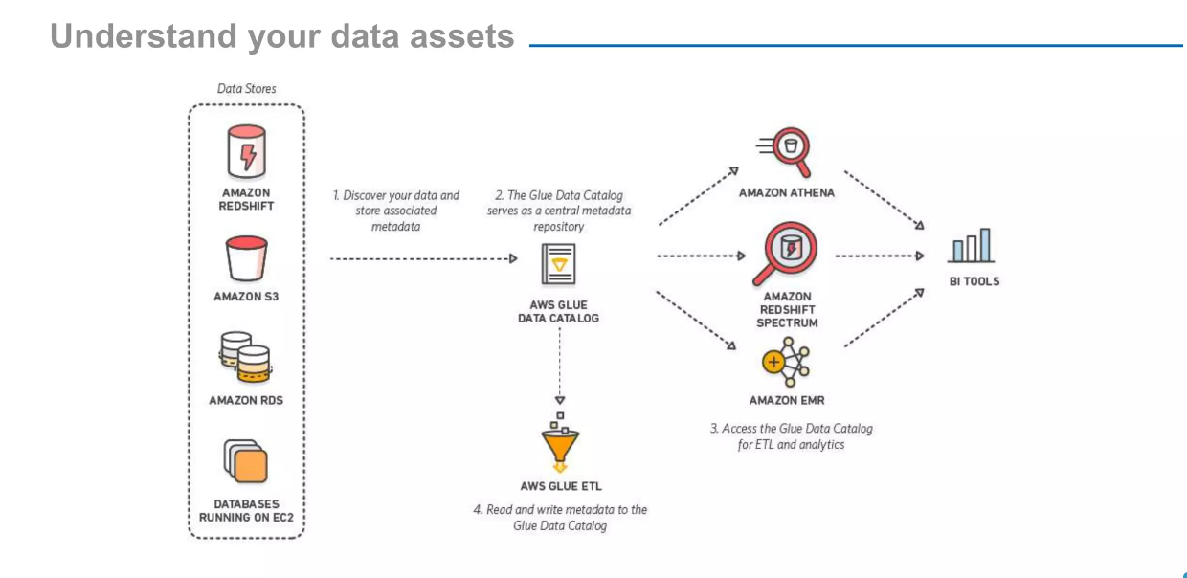
AWS GLUE

Slide 4
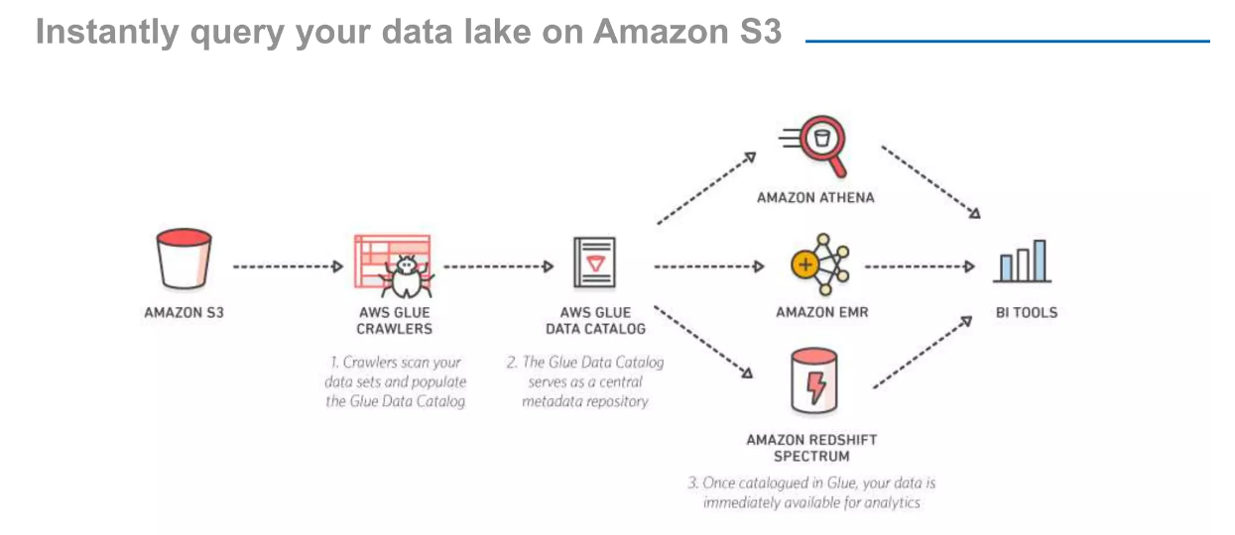
AWS GLUE

Slide 5
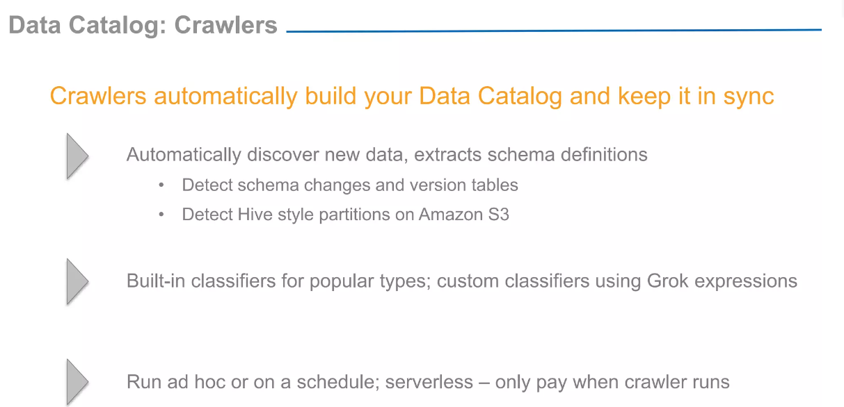
AWS GLUE

Slide 6
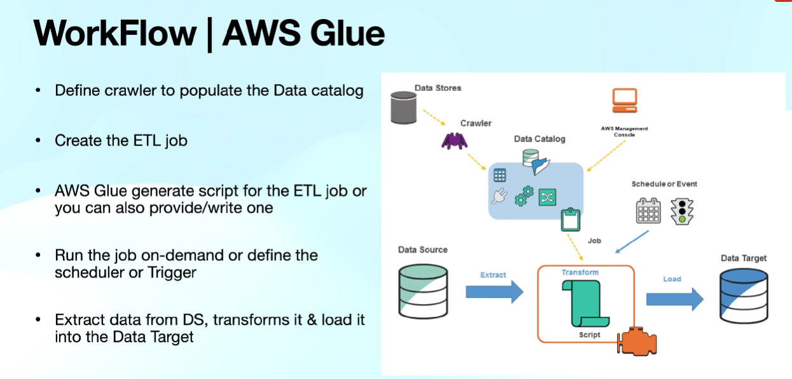
AWS GLUE

Slide 7
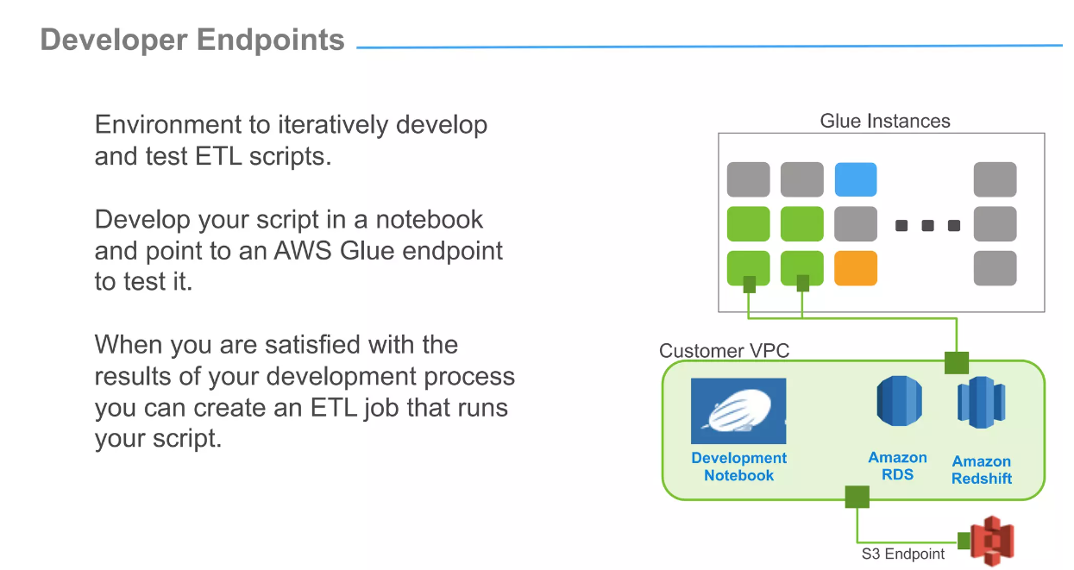
AWS GLUE

Slide 8

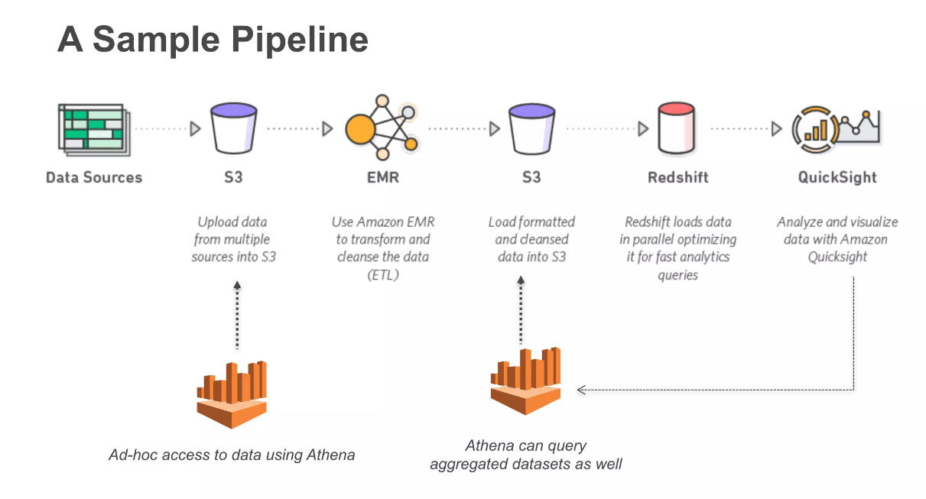
AWS Athena

Slide 9


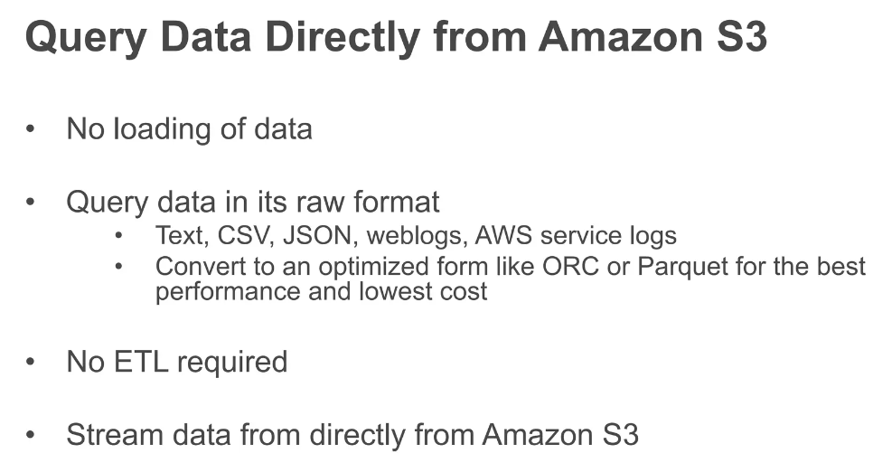
AWS Athena

Slide 10

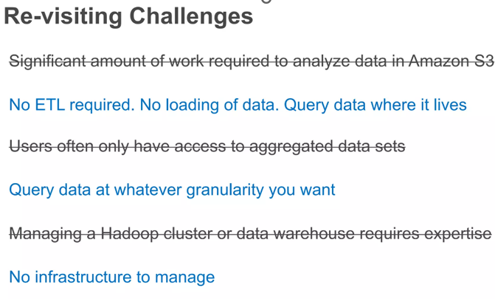
AWS Athena

Slide 11
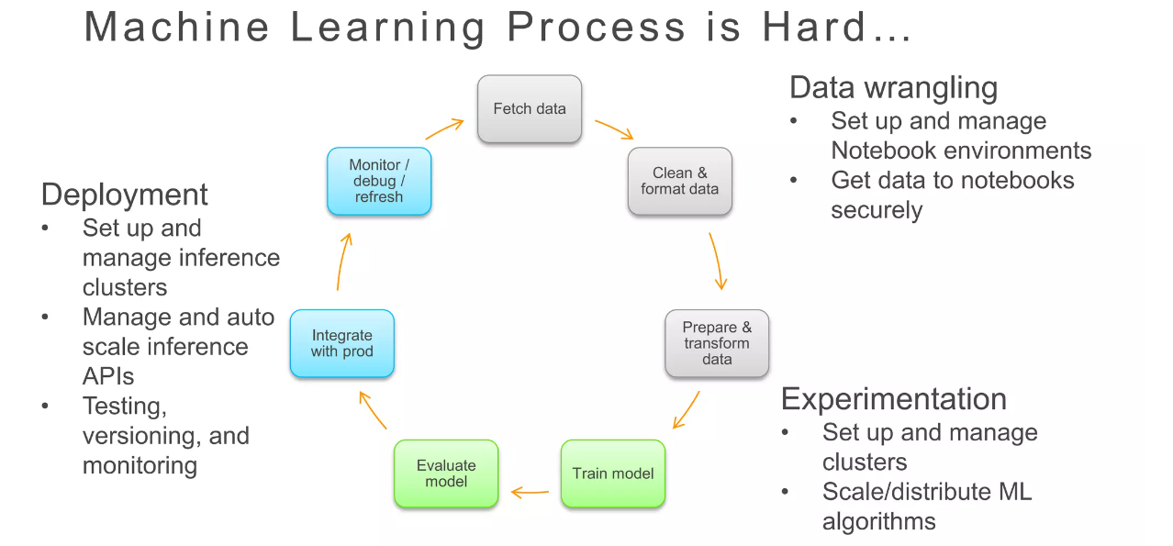
AWS Sagemaker

Slide 12
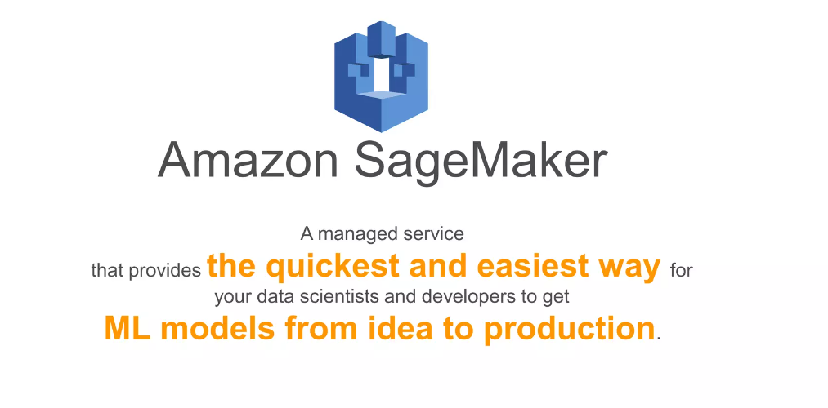

AWS Sagemaker Data Wrangler

Slide 13
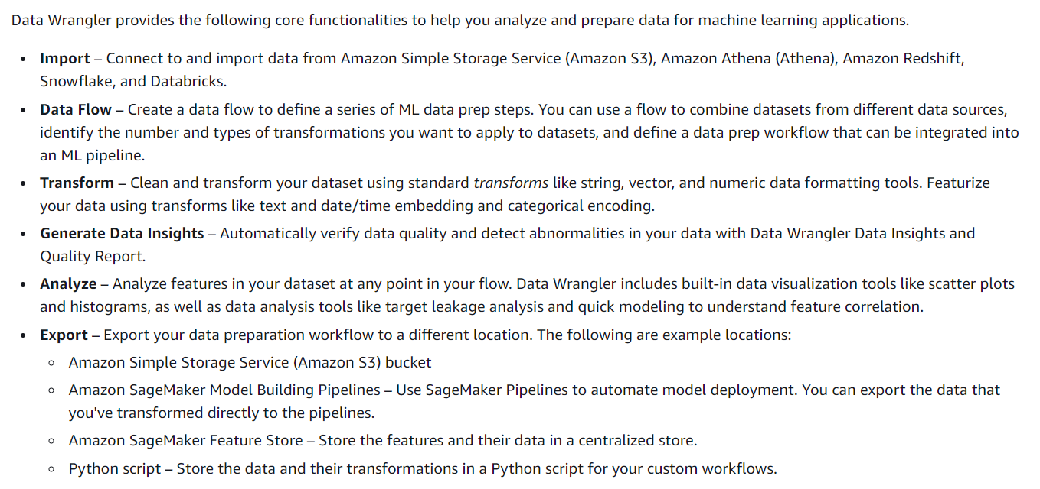
AWS Sagemaker Data Wrangler

